Slide 1

Introduction to Computer Systems
Input / Output Architecture
Direct Link to view these slides on Google Docs

Slide 2
What to expect in this topic:
I/O organization
I/O interface
Asynchronous data transfer
Asynchronous serial transmission
Modes of data transfer
Interrupt initiated I/O
Direct memory access (DMA)

Slide 3
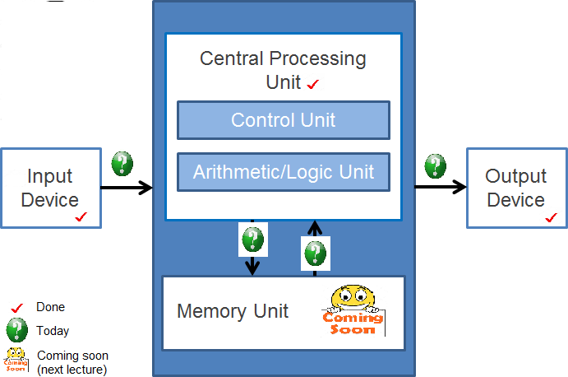
What to expect in this topic:

Slide 4
Input / Output Architecture
Which is more important?
Processor & memory design?
Input / Output system design?
Processor & memory will dominate computationally intensive programs
Performance is measured in MFlops (a common measure of the speed of computers used to perform mega floating-point calculations).
Also, MIPS (million instructions per second).
I/O system will dominate web server systems
E-commerce
Performance measured in transactions per second
I/O system design may be more critical than processor design
I/O system consists of interfaces and I/O devices themselves

Slide 5
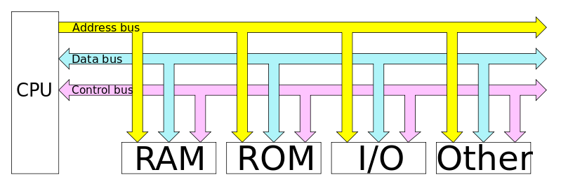
I/O Buses
I/O bus allows many devices to connect to the processor
Any device compatible with a bus can connect with a device driver software
Multiple devices must compete for access to the bus
Disadvantage: bus has fixed bandwidth
Multiple busses allow faster attachment

Slide 6
Interrupts
Asynchronous events cannot be predicted e.g. key press
Interrupts allow devices to request service from the processor
Block transfer devices (disks) use interrupts to signal end of block transfer.

Slide 7
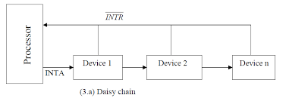
Interrupts
Interrupt request line and interrupt acknowledge line are on the processor
Device signals on request line until processor signals on acknowledge line
Interrupt vector contains addresses of interrupt service routines (inserted by operating system)
An interrupt vector is the memory location of an interrupt handler, which prioritizes interrupts and saves them in a queue if more than one interrupt is waiting to be handled

Slide 8
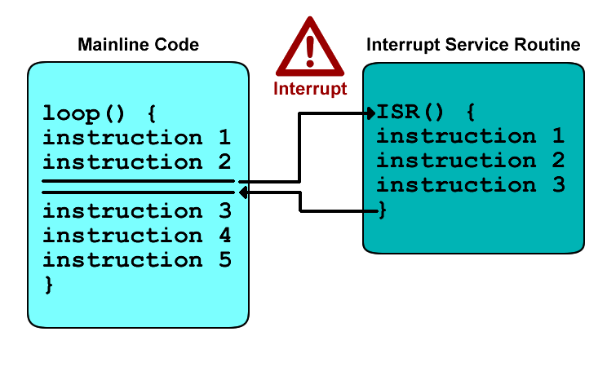
Interrupt Servicing
Processor transfers control to appropriate address
Service routine responsible for saving current state of processor (context) and restoring it on return
Interrupt invisible to user processes (except through reading clock)

Slide 9
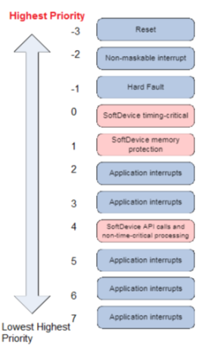
Interrupt Priority
Interrupts may have a priority
Processor may mask off interrupts below a certain priority - forcing them to wait until higher priority interrupts services
Low priority interrupt servicing might be interrupted by higher priority interrupt

Slide 10
Polling vs Interrupts
Polling (software) and Interrupt (hardware) let CPU stop what it is currently doing and respond to the more important task.
Polling CPU keeps on checking I/O devices at regular interval whether it needs CPU service whereas, in interrupt, the I/O device interrupts the CPU and tell CPU that it need CPU service.

Slide 11
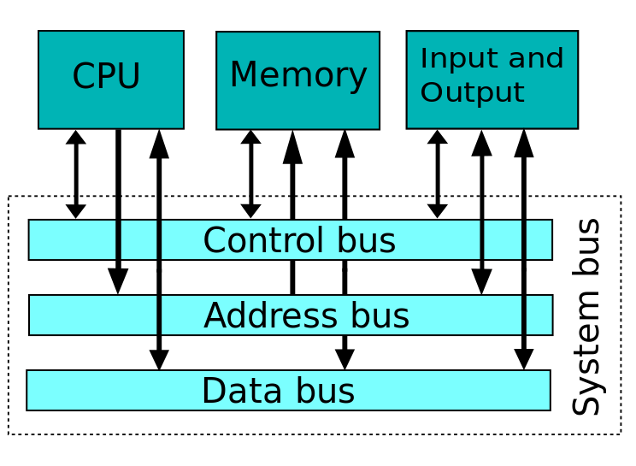
Buses
Buses connect the processor, memory and I/O devices
Bandwidth is how much data can be transferred per second
Bus Design
Conflict between speed of access and bandwidth
Fast response time requires a short physical bus and small amounts of data
High bandwidth suggests large amounts of data in each transfer

Slide 12
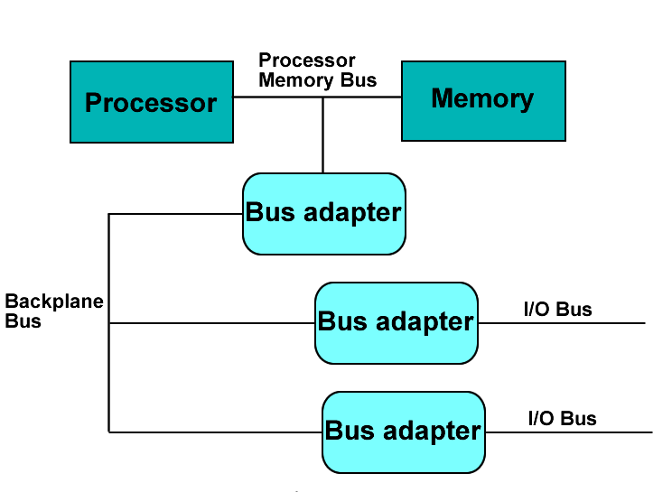
Bus Types
Processor- memory bus
Short, high speed, matched to memory and processor speed
I/O bus
Lengthy, suitable for many types of I/O devices
Typically not directly connected to the memory
Backplane bus
Used to interconnect processor, memory, I/O devices and other buses

Slide 13
Accessing I/O Bus
Different buses (SCSI, IDE, PCI, USB,...) each have their own protocols
SCSI: each device has an address
In conflicts for access higher address has priority
Starvation possible for low addresses
Arbitration policy can be used to give waiting devices access
*USB - each device gets a new address when it connects
*USB devices are polled to see if they need receive or transmit data.

Slide 14
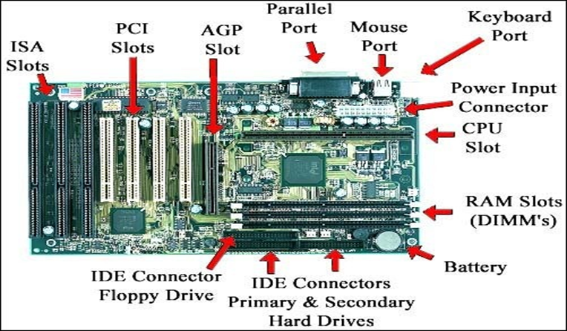
Buses

Slide 15
Buses
cache bus
local bus
memory bus
level 2 cache
PCI bridge
CPU
RAM
PCI bus
IDE bus
SCSI
USB
graphic adaptor
ISA bridge
IDE disk
USB bus
available slots
SCSI bus
hard drives and CD or DVD drives
mouse
keyboard
monitor
SCSI disk drives, tape drives, CD-ROM
ISA bus
modem
sound card
printer
ISA: Industry Standard Architecture
USB: Universal Serial Bus
PCI: Peripheral Component Interconnect
SCSI: Small Computer System Interface
IDE: Integrated Drive Electronics

Slide 16
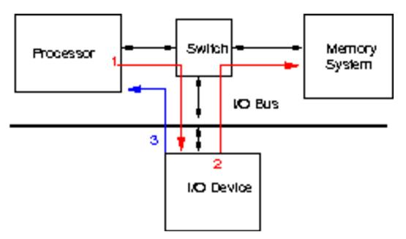
DMA - Direct Memory Access
Devices such as disk transfer large amounts of data
Significant overhead if processor has to move each byte or word individually
Allow device driver to access memory directly

Slide 17
Disks
A hard drive example:
surface 3
surface 2
surface 1
surface 0

Slide 18
Disks
sector
cylinder
track
heads
For more information on how hard drives work - please visit https://www.youtube.com/watch?v=NtPc0jI21i0 and https://www.youtube.com/watch?v=wteUW2sL7bc

Slide 19

Disks
read & write: 13 parameters in 9 bytes
1) address of the disk;
2) number of surface;
3) number of cylinder;
4) number of track;
5) kind of recording mode
(continuous, interleaf, ...);
6) what to do if the data is not found;
7) ...
heads
is the motor on? is the motor off?
JUST GIVE ME A READ & WRITE INSTRUCTION
(that is an extended or virtual computer)

Slide 20
Disk Access
Time to fulfil a disk request is made up of:
Seek time - moving heads to the correct track
Rotational latency - waiting for correct sector to reach the read / write heads
Transfer time - depends on speed of rotation

Slide 21
I/O Summary
I/O system design may be more critical than processor design
Interrupts used to signal end of I/O operations
Polling involves processor checking each device in turn to see if it needs service.

